Slide 1
Week 2 Live Session
Wendy Christensen, Ph.D.
COMP 4442
Spring 2021

Slide 2
Agenda
Administrivia
Problem Set 1 questions
Two-way ANOVA
Non-independence / Pseudoreplication / Longitudinal designs
Problem Set 2 review

Slide 3
Upcoming deadlines (all 11:59 p.m. MDT)
Week 1 Participation: Due Sunday, 4/4 (past due, please get these in)
Problem Set 1: Due this Friday, 4/9
Week 2 Participation: Due this Sunday, 4/11
Assigned today: Problem Set 2, due 4/16 (next Friday)
You can view all deadlines in this course by downloading the Assignment and Topic Schedule document in the Files tab. If these change, then a new one will be posted and the date of the posting will be part of the file name

Slide 4
Office hours
Office hours will be on Thursdays from 6:00 - 8:00. The Zoom links will be posted soon after this live session.
You’re welcome to come to office hours to discuss assignments, old material, future material, or to hang out.
No new material will be presented during office hours, so office hours will not be recorded.
If you cannot make office hours and/or you want to ensure that you can discuss something privately, it’s best to make an appointment with me.

Slide 5
Problem Set 1 questions?

Slide 6
Two-way ANOVA

Slide 7
Data requirements of n-way ANOVA
As the existence of “one-way” ANOVA may suggest, n-way (n > 0) ANOVA analyses are also possible.
The data requirements of n-way ANOVA are similar to that of one-way ANOVA. You must have a continuous dependent/outcome variable, and your observations must have information about their membership in n grouping variables.
In theory, any n is possible (e.g., 36-way ANOVA), but such designs are untenable in practice. The most common of these is two-way ANOVA.

Slide 8
Two-way ANOVA
Two-way ANOVA involves observations that have “memberships” in two different variables (a.k.a. factors). Factors always have at least two levels; if not, such a factor would be a constant (that is, all observations would have the same “membership”) and couldn’t be included in the ANOVA.
If all combinations of the two factors exist in your data, then this is referred to as a factorial ANOVA. By convention, such analyses are referred to in speech as “#A by #B ANOVA” and in writing as “#A x #B ANOVA”. That is, if your analysis has 2 factors, both with 3 levels, it would be denoted as a 3 x 3 ANOVA.

Slide 9
Two-way ANOVA and interactions
When conducting a factorial ANOVA, you have the ability to examine the main effects associated with the factors and the interaction among the factors. For a two-way factorial ANOVA, there are three effects that can be evaluated:
Main effect of Factor A on the outcome variable
Main effect of Factor B on the outcome variable
The interaction of the effect of Factor A and Factor B on the outcome variable
Main effects have the same null hypotheses as they would if you conducted a one-way ANOVA for each factor. The interaction is more complicated.

Slide 10
Two-way ANOVA and interactions
Null of main effect of Factor A: The means of all levels of Factor A are equal Alternative: At least one level of Factor A has a different mean.
Null of main effect of Factor B: The means of all levels of Factor B are equal Alternative: At least one level of Factor B has a different mean.
Null of interaction effect of Factors A and B: There is no evidence of an interaction between Factors A and B Alternative: There is evidence of an interaction between Factors A and B; that is, the effect of one factor depends on the level of the other factor

Slide 11
Partitioning sums of squares
Source | SS | DF | MS | F | p
Factor A | SSA | a - 1 | SSA/(a-1) | MSA/MSE | p-value
Factor B | SSB | b - 1 | SSB/(b-1) | MSB/MSE | p-value
Int A*B | SSAB | (a-1)*(b-1) | SSAB/[(a-1)*(b-1)] | MSAB/MSE | p-value
Error | SSE | N - a - b - 1 | SSE/(N - a - b - 1)
Total | SST | N - 1
As in one-way ANOVA, the goal is to properly partition sums of squares. The partitioning is now more sophisticated.

Slide 12
Partitioning sums of squares
Source | SS | DF | MS | F | p
Factor A | SSA | a - 1 | SSA/(a-1) | MSA/MSE | p-value
Factor B | SSB | b - 1 | SSB/(b-1) | MSB/MSE | p-value
Int A*B | SSAB | (a-1)*(b-1) | SSAB/[(a-1)*(b-1)] | MSAB/MSE | p-value
Error | SSE | N - a - b - 1 | SSE/(n - a - b - 1)
Total | SST | N - 1
a = the number of levels in Factor A b = the number of levels in Factor B

Slide 13
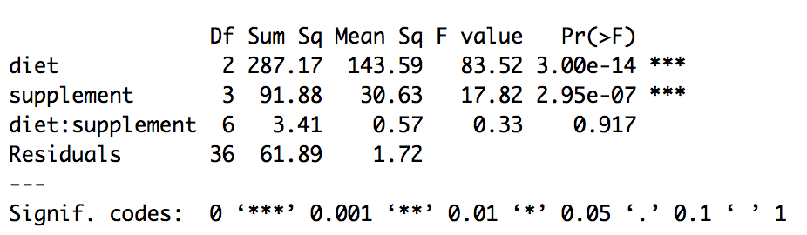
Partitioning sums of squares
From the async example in 1.3.1. The outcome was the weight gained by animals based on their diets and supplements added (factorial design).
Using just this table, how many levels of each factor were there?

Slide 14
Two-way ANOVA and interactions
Main effects answer this question: Ignoring the existence of all other variables, what is the effect of the factor on the outcome variable?
The interaction effect answers this question: Does the effect of one factor on the outcome variable depend on the level of the other factor?
The presence of an interaction complicates the interpretation of main effects. That is, if the effect of one factor depends on the the level of another factor, then it’s difficult to justify ignoring the existence of the other factor.

Slide 15
Two-way ANOVA and interactions: Example
A media marketing group wants to determine the effect of different types of advertising and the effect of franchise on excitement about upcoming superhero movies. They recruit 80 participants (20 per condition) and randomly assign them to view one of four 30-second movie trailers:
 | Explosions | No Explosions
Billed as a Marvel movie | Explosions + Marvel | No Explosions + Marvel
Billed as a DC movie | Explosions + DC | No Explosions + DC

Slide 16
Two-way ANOVA and interactions: Example
The outcome variable is each participant’s response to this question: One a scale of 1 (no chance) to 10 (certainly will), how excited are you to see this movie? The following table contains the group means - often called cell means - for each condition.
 | Explosions | No Explosions
Billed as a DC movie | 6 | 3
Billed as a Marvel movie | 9 | 6

Slide 17
Two-way ANOVA and interactions: Example
We answer the question about the main effect of franchise by comparing the means for the two franchises; these are often called marginal means. We’re ignoring the effect of explosions, so there are only two means to compare.
 | Explosions | No Explosions | Franchise means
Billed as a DC movie | 6 | 3 | (1) 4.5
Billed as a Marvel movie | 9 | 6 | (2) 7.5

Slide 18
Two-way ANOVA and interactions: Example
We answer the question about the main effect of presence of explosions in the trailers by comparing the means for the two levels of explosion. We’re ignoring the effect of franchise, so there are only two means to compare.
 | Explosions | No Explosions
Billed as a DC movie | 6 | 3
Billed as a Marvel movie | 9 | 6
Explosion means | (1) 7.5 | (2) 4.5

Slide 19
Two-way ANOVA and interactions: Example
To test the interaction, we have to compare all four condition means. A significant interaction term has two equivalent interpretations:
The effect of franchise depends on whether or not explosions are present, OR
The effect of the presence of explosions depends on whether the trailer is billed as Marvel or DC.
The interaction can be tested quantitatively, but can also be assessed informally by creating an interaction plot (i.e., a bar or line plot of the condition means).

Slide 20
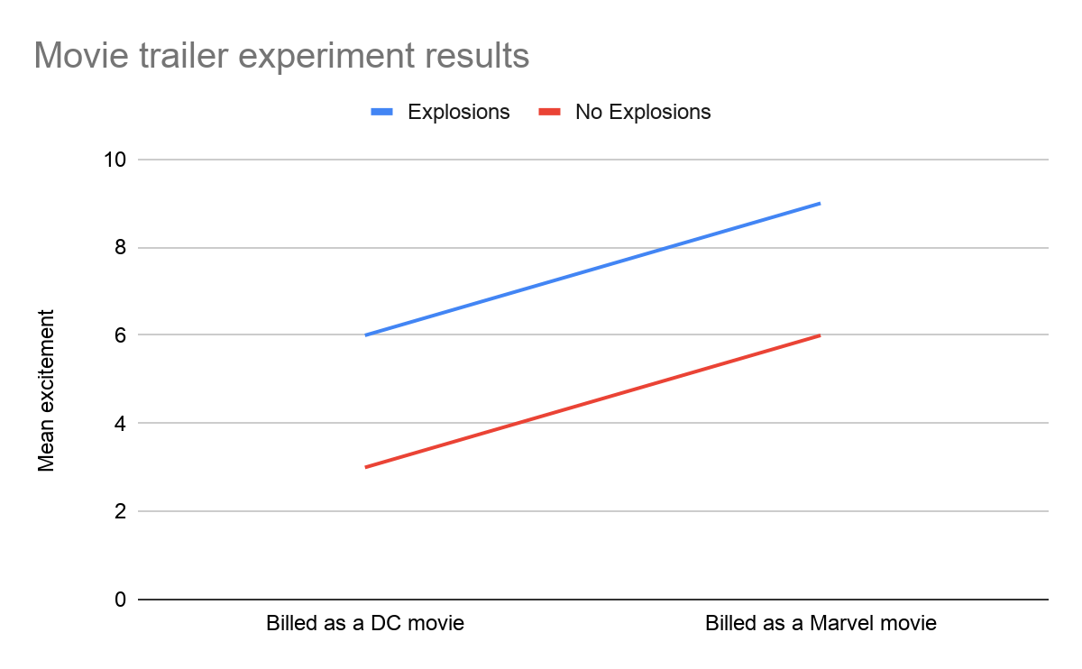
Two-way ANOVA and interactions: Example
Lines that are parallel (or close to being so) suggest that there is no interaction, while non-parallel lines suggest that there is an interaction.
Why?
The p-value of the quantitative test for this particular (fake) data set was in fact very high, so null of the interaction effect was not rejected.

Slide 21
Two-way ANOVA and interactions: Example
Since the interaction wasn’t significant, we can interpret the main effects in a straightforward fashion. If the interaction had been significant, the interpretation of the main effects is less straightforward because you have evidence that the other factor can’t be ignored.
It is still possible to examine the separate effects of franchise and and explosions; a common method of doing so is examining simple effects. That is, holding the level of one of the factors constant, what is the effect of the other factor? This is outside the scope of the course, but much has been written about tests of simple effects (e.g., http://rcompanion.org/handbook/G_09.html)

Slide 22
Non-independence

Slide 23
Pseudoreplication (Hurlbert, 1984)
“Pseudoreplication may be defined, in analysis of variance terminology, as the testing for treatment effects with an error term inappropriate to the hypothesis being considered … Psuedoreplication thus refers not to the problem in experimental design (or sampling) per se but rather to a particular combination of experimental design (or sampling) and statistical analysis which is inappropriate for testing the hypothesis of interest.” (p. 190).
The problem Hurlbert refers to as pseudoreplication is a subtype of a broader problem - a lack of independence in observations.

Slide 24
Assumption of independence
Statistical independence (or the lack thereof) is fundamentally about the relationships among observations. If observations are independent, then knowing something about one observation won’t tell you anything about the other. If not, then the observations are not independent and this assumption is not met.
While metrics exist that can quantify a lack of independence (e.g., the intraclass correlation), this assumption is best assessed by knowing how the data were collected. It’s very important to not violate this assumption. Unless you are given reason to think otherwise, you may assume independence in this course.

Slide 25
Nesting/clustering
A common source of non-independence is when a natural nesting/clustering structure exists in your data.
Example: I collect data from children who have at least one alcoholic parent. To help increase my sample size, I also collect data from any siblings a given child has.
What is the nesting/clustering structure that exists in this scenario?
Children are nested/clustered within families; children within the same family are not independent

Slide 26
What happens if data are non-independent?
If data that contain non-independence of observations are treated as though they are independent, the parameters of the model will generally be unbiased, but the variability of those estimates (e.g., standard errors) will be too small (i.e., “downwardly biased”).
This causes the test statistics (e.g., the F test statistic) to be higher than it should be, meaning that the Type 1 error rate for that test is inflated. That is, you will improperly reject the null hypothesis and conclude that there is some kind of effect more often than you expect; this is referred to as “type 1 error inflation”.

Slide 27
Handling non-independent data
There are numerous ways to conduct analyses with non-independent data. Just like with independent data, what you use depends on the questions you want your analysis to answer and the qualities of your data. Some examples include:
Split-plot designs
Random effects ANOVA
Multilevel modeling (i.e., random coefficient modeling, hierarchical modeling)
Generalized estimated equations models
...and more.

